Slide 1
Ilig sang Lahi: Language, Literature and Culture Module on Philippine Literature
Dr. Pia Arboleda
Assistant Professor of Filipino and Philippine Literature
University of Hawai’i at Manoa

Slide 2
The Importance of Literature
Video clip

Slide 3
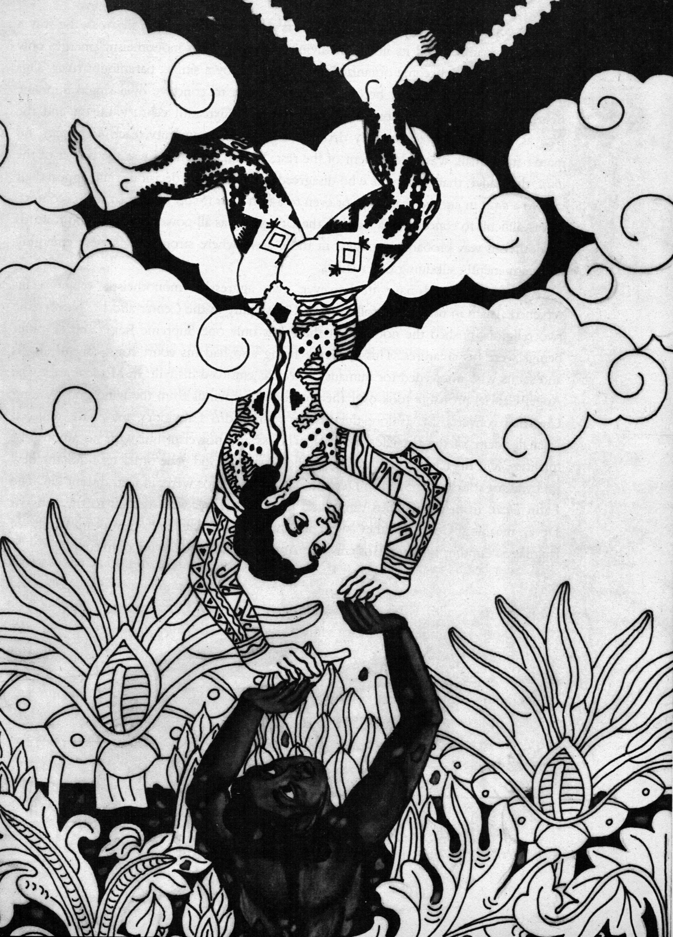
Background on Philippine Literature and Folklore
artwork by
robert feleo
from The Soul Book

Slide 4
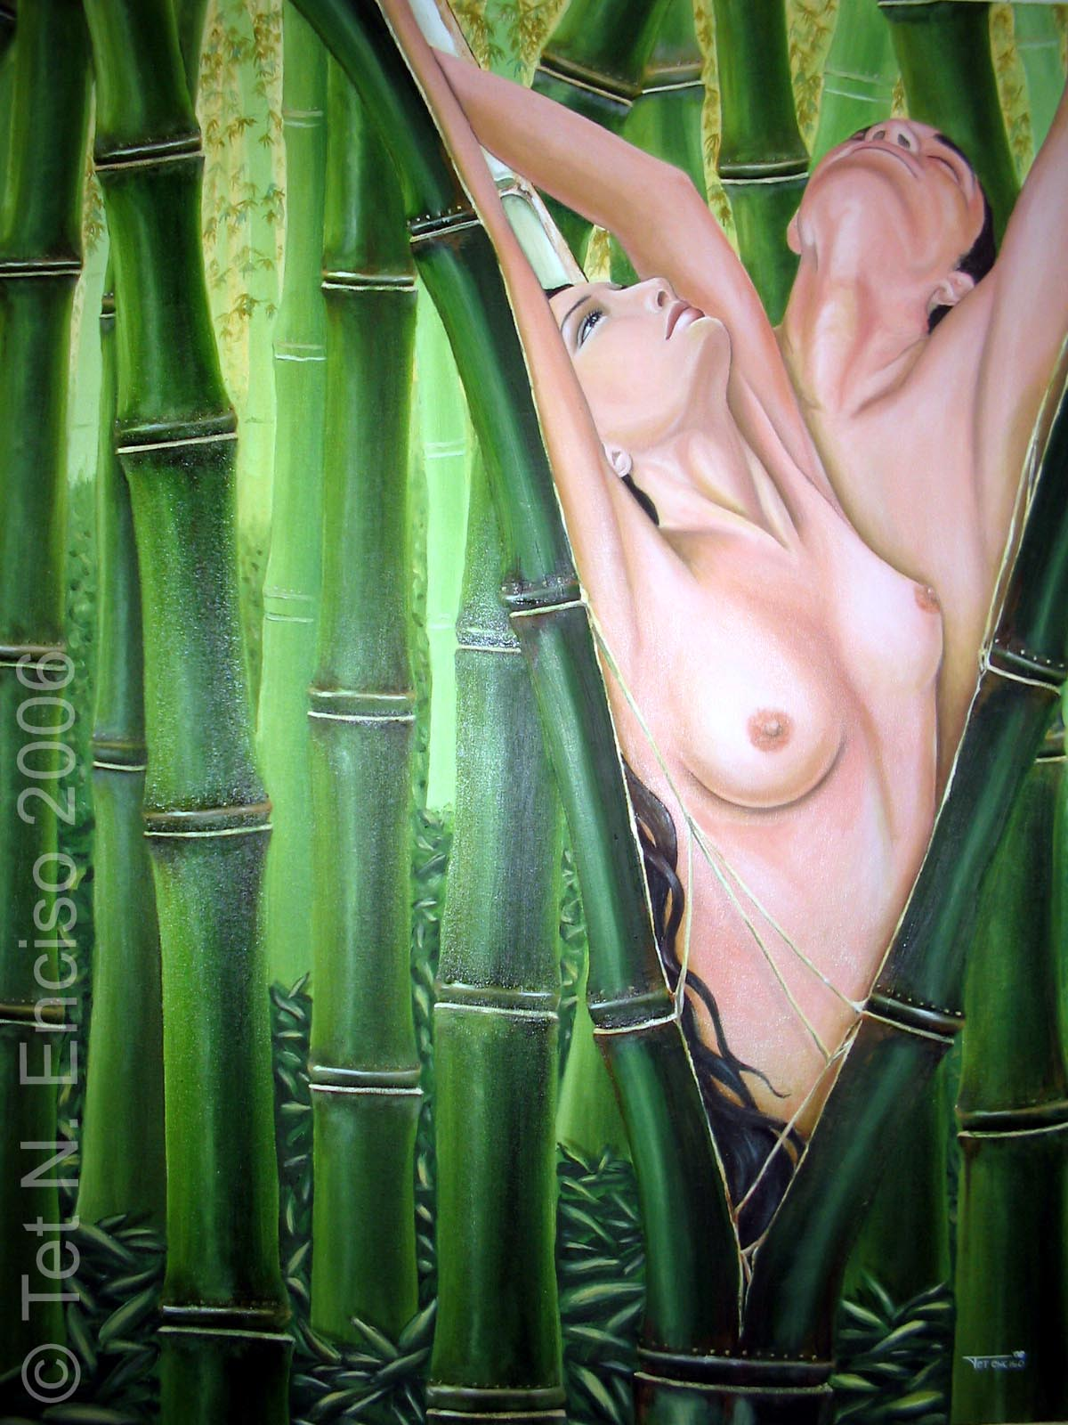
Malakas at Maganda
artwork by tet enciso
up baguio

Slide 5
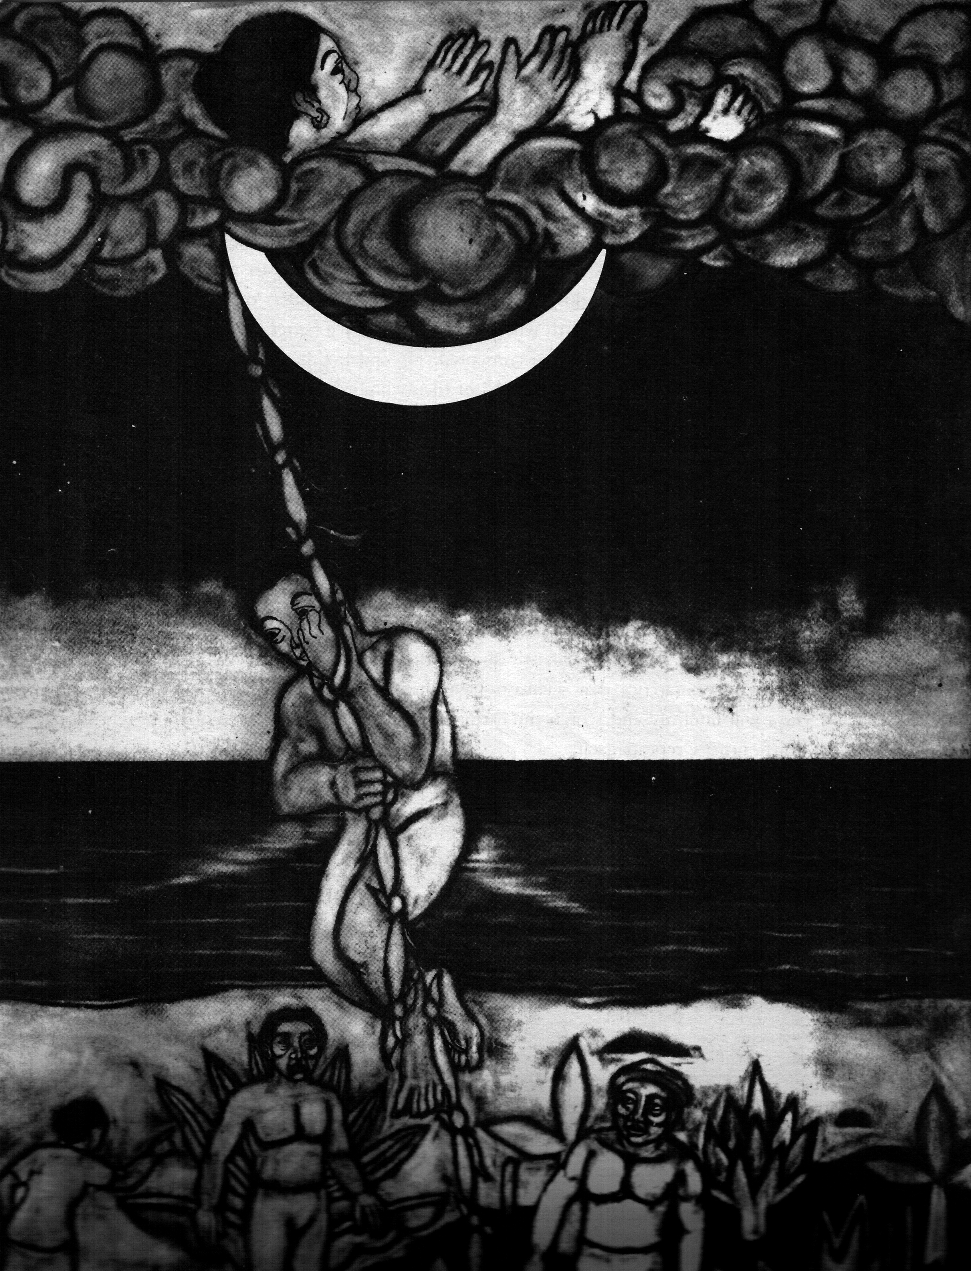
Heavenly inhabitants descended to earth except one fat woman who got stuck in the hole and became the moon.
artwork by
robert feleo
from The Soul Book

Slide 6
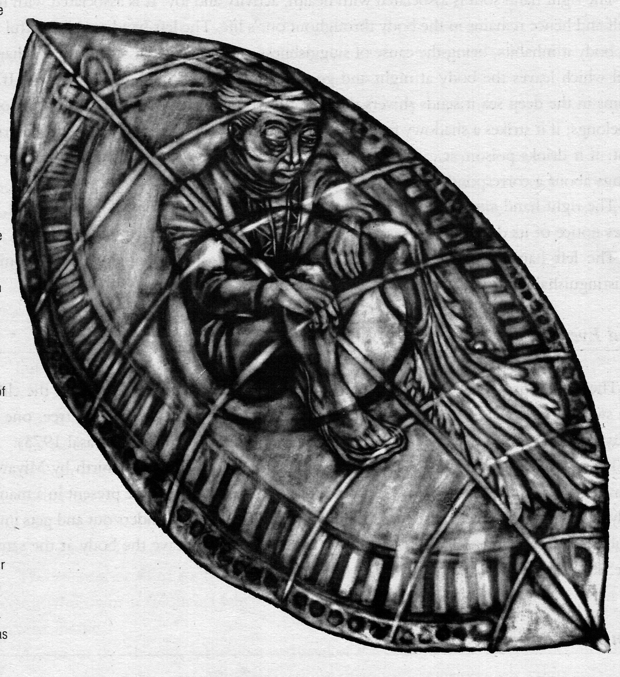
The soul of the dead or gimokud sits on a leaf and waits until the hot rays of the sun dissolves it into water.
artwork by
robert feleo
from The Soul Book

Slide 7
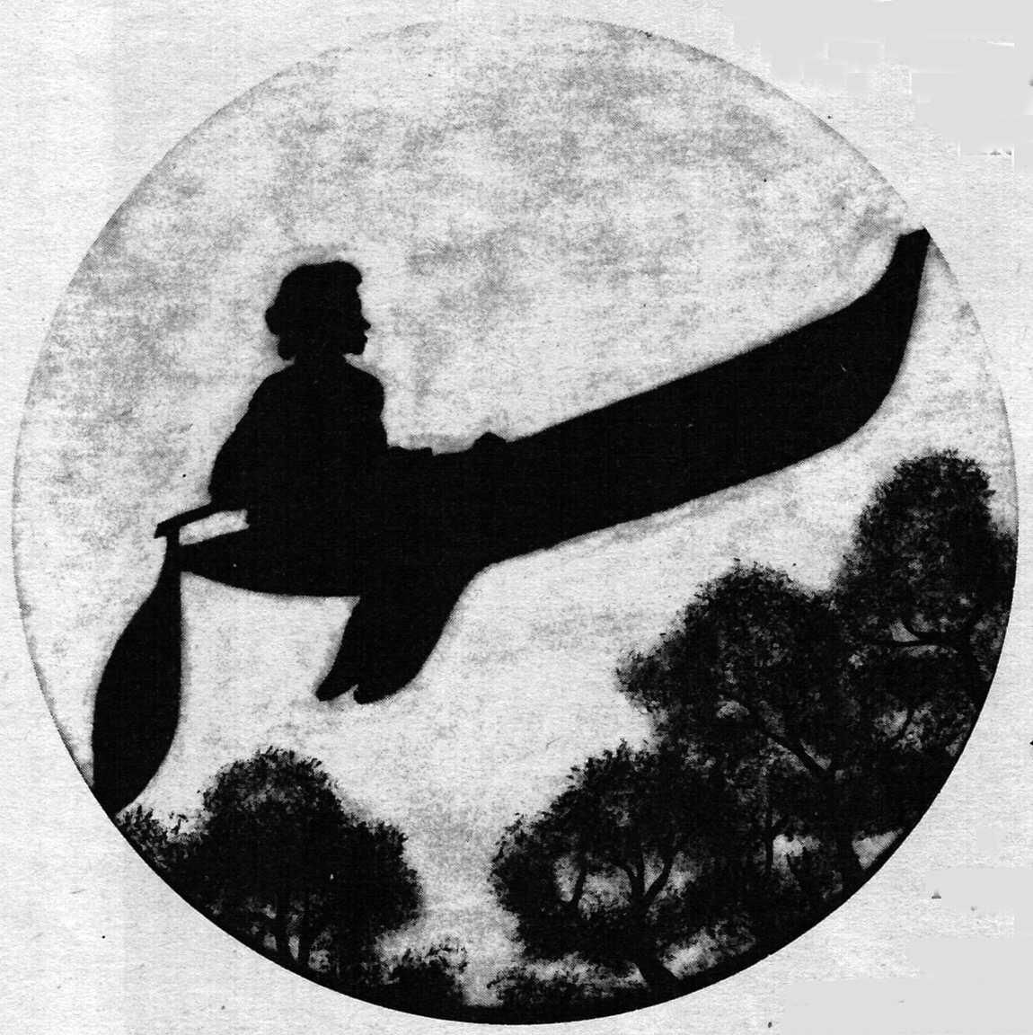
artwork by
robert feleo
from The Soul Book
The Bukidnons speak of a spirit boat, the salimbal, that can transport people to the skyworld without having to die.

Slide 8
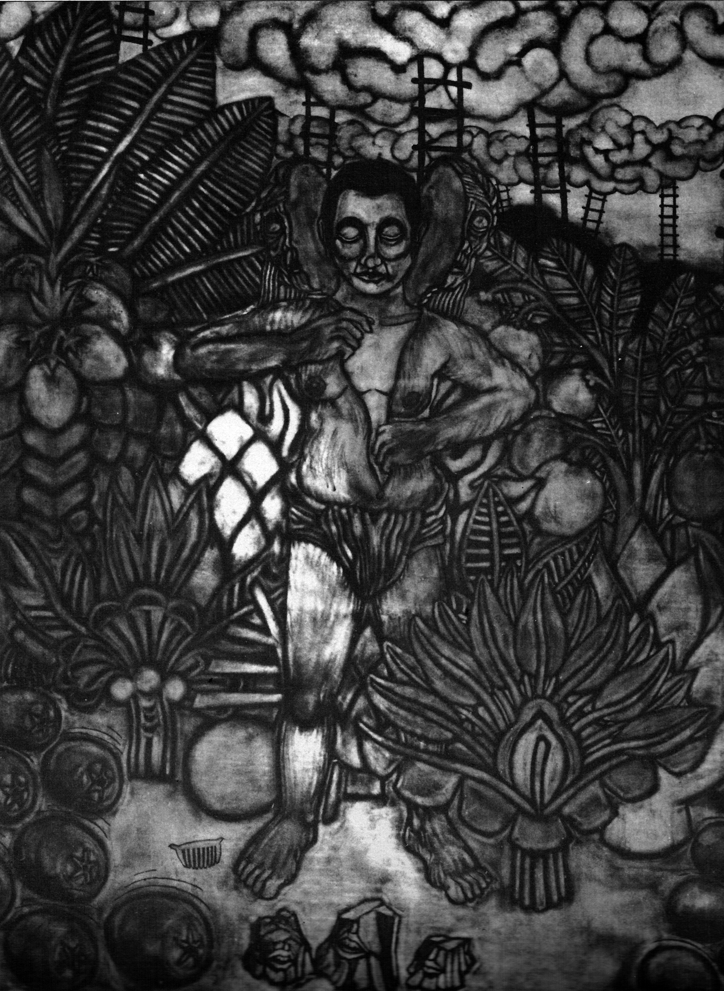
When people aged they merely changed their skins like a snake, and were young again.
artwork by
robert feleo
from The Soul Book

Slide 9
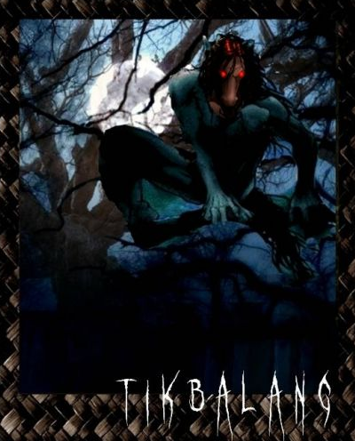
Tikbalang or tigbalang
(horse demon) has a horse's head, the body of a human but with the feet of the horse (the opposite of the Greek centaur)
It travels at night to rape female mortals. The raped women will then give birth to more tikbalang. They are also believed to cause travelers to lose their way in mountains or forests. Tikbalangs usually make a person imagine things or drive a person crazy.
Legends say that when rain falls while the sun is shining, a pair of Tikbalangs are being wed.
[Kapag umuulan tuwing umaaraw, may ikinakasal na tikbalang.]

Slide 10
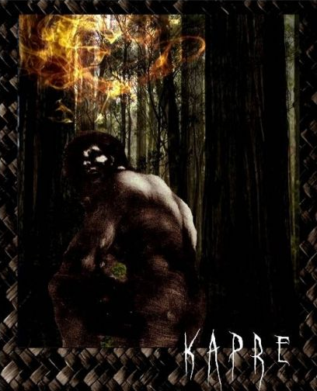
kapre (related to the Agta in the Visayan dialect)
a tree demon, but with more human characteristics
a tall (7 to 9 ft), brown, hairy male with a beard
seen smoking a big tobacco pipe, whose strong smell would attract human attention
http://hubpages.com

Slide 11
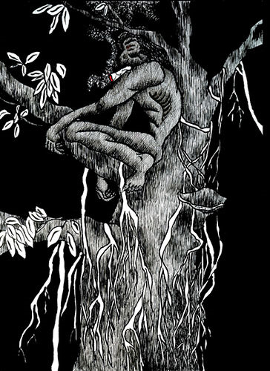
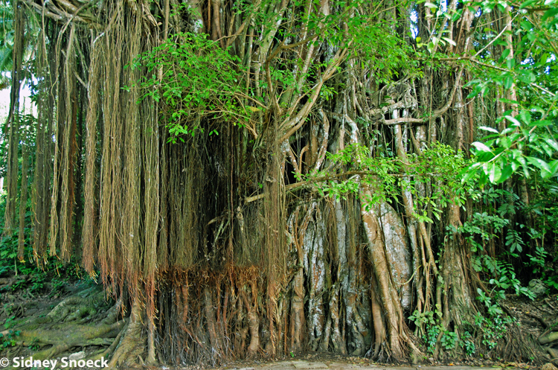
Kapres are said to dwell in big trees like acacias, mangoes, bamboo and banyan (balete). It is also mostly seen sitting under those trees.
The Kapre wears a bahag (northern Philippines loincloth) and often wears a belt which gives
the kapre the ability to be
invisible to humans.

Slide 12
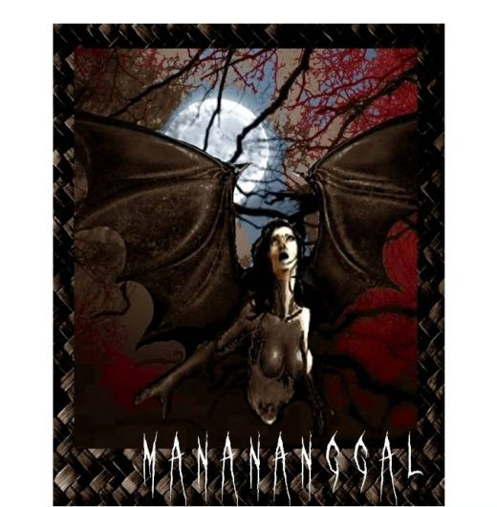
A manananggal—an older, beautiful woman (as opposed to an aswang) capable of severing its upper torso in order to fly into the night with huge bat-like wings to prey on unsuspecting, pregnant women in their homes; using an elongated proboscis-like tongue, it sucks the hearts of fetuses or the blood of an unsuspecting, sleeping victim.
http://hubpages.com

Slide 13
The severed lower torso is left standing and it is said to be the more vulnerable of the two halves. Sprinkling salt or smearing crushed garlic or ash on top of the standing torso is fatal to the creature. The upper torso then would not be able to rejoin and will die at daybreak.
In the Visayan provinces, people still hang cloves of garlic or onion around windows and doors to repel the aswang.

Slide 14
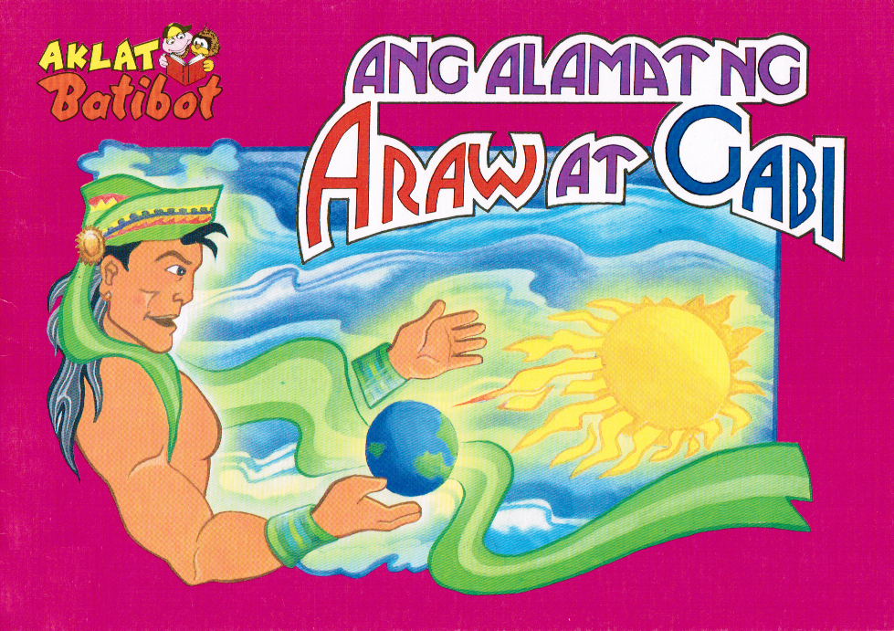
Materials on Philippine Literature

Slide 15
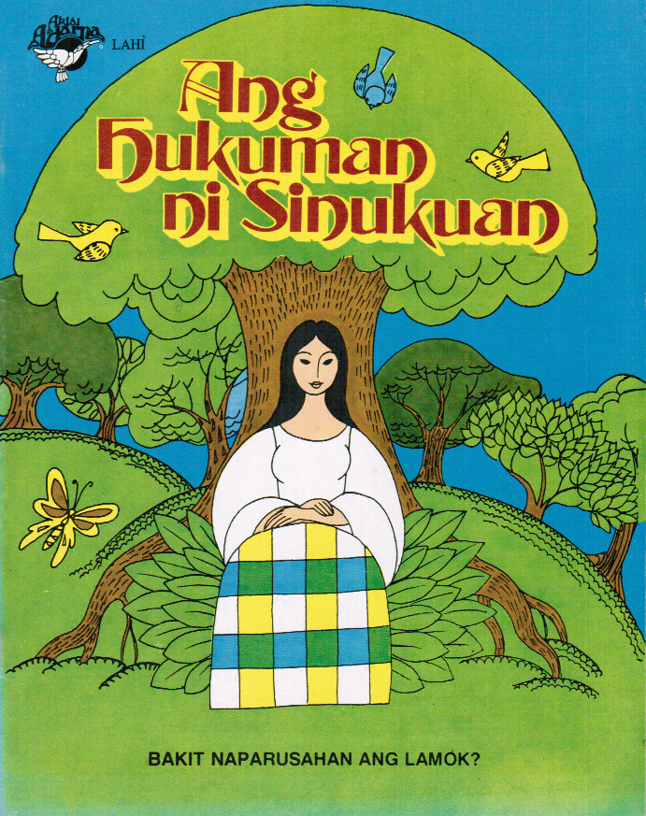

Slide 17
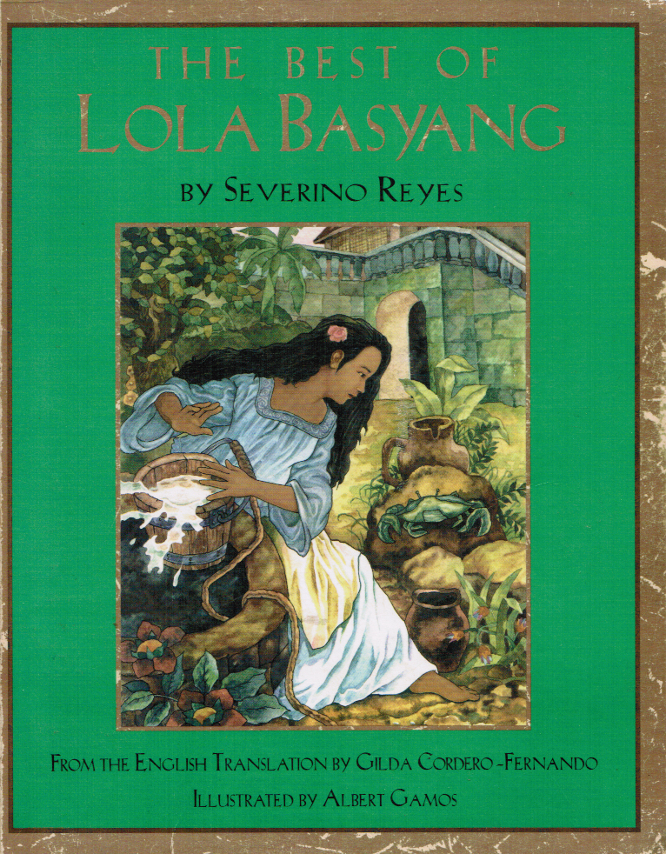

Slide 18
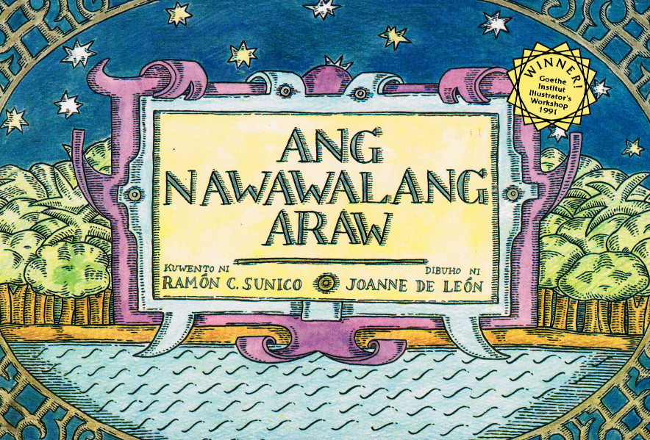

Slide 20
Video clip
Two Friends, One World (Mata at Mangga) by Ramon C. Sunico
Joanne de Leon, artist
Pia Arboleda, production and narration

Slide 21
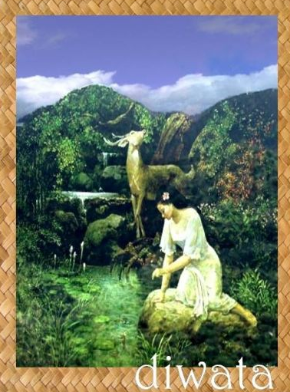
Some Strategies
Creative writing strategies
Writing a character sketch
Drawing a literary map or life map of characters
Oral history projects and photo elicitation

Slide 22
Processing Activity
Group yourselves according to grade level or subject area.
Considering the needs and background of Filipino students, create a short lesson or list of activities using Two Friends, One World as the main text or as a motivational tool.

Slide 23
Maraming salamat po!
For questions or comments: pca62@hawaii.edu

